Slide 1
Student Connect
Team 5
Team Lead: Kao Saephan, Scrum Master: Sean Ibarra Diaz, Back End Lead: Luke Thilgen, Front End Lead: Collins Gichohi, Git-Master: Zacharia Angha, Front Assist: Salvador Avila.

Slide 2
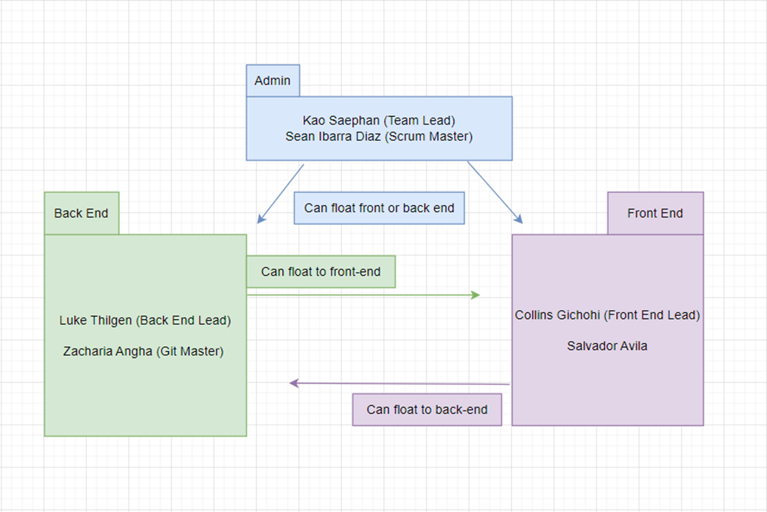
Team Lead: Kao
Subteams breakdown
Parallel Development
Admin Team
People, Paper, Points

Slide 3
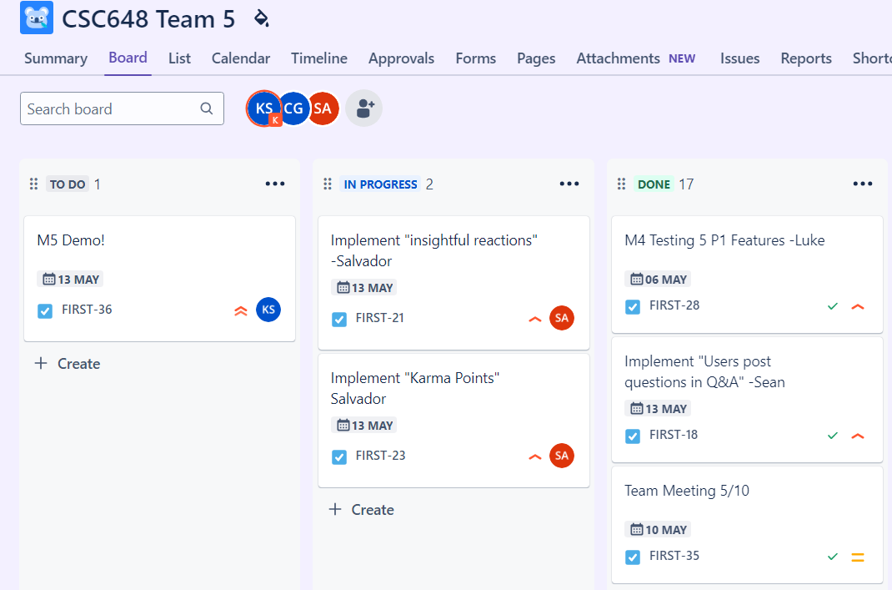
Task Management (High Level)
High level view
High level scope
Allow section leads to manage specifics

Slide 4
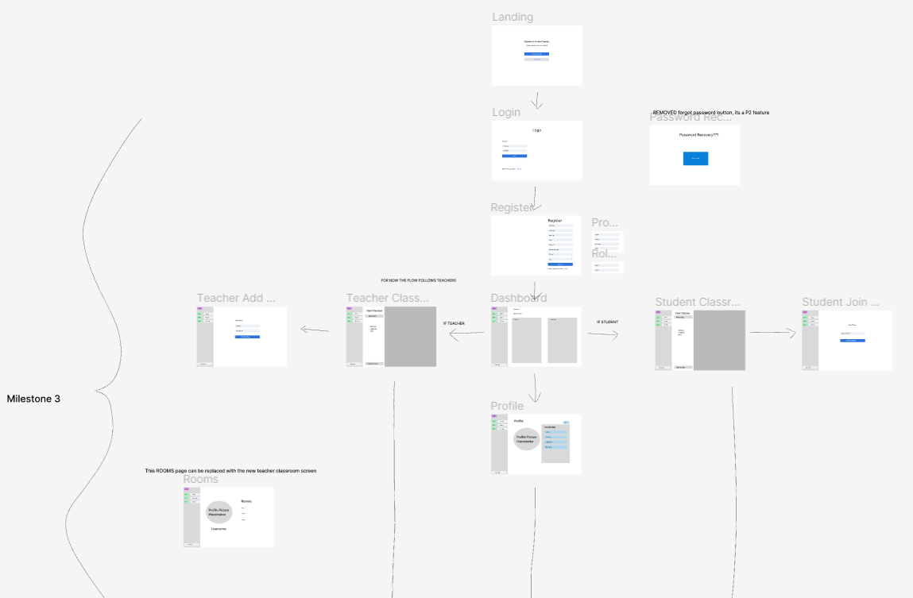
Figma 1/3
High Level vision
Fully Interactable
Start to Finish
Keep the team on the same page!

Slide 5
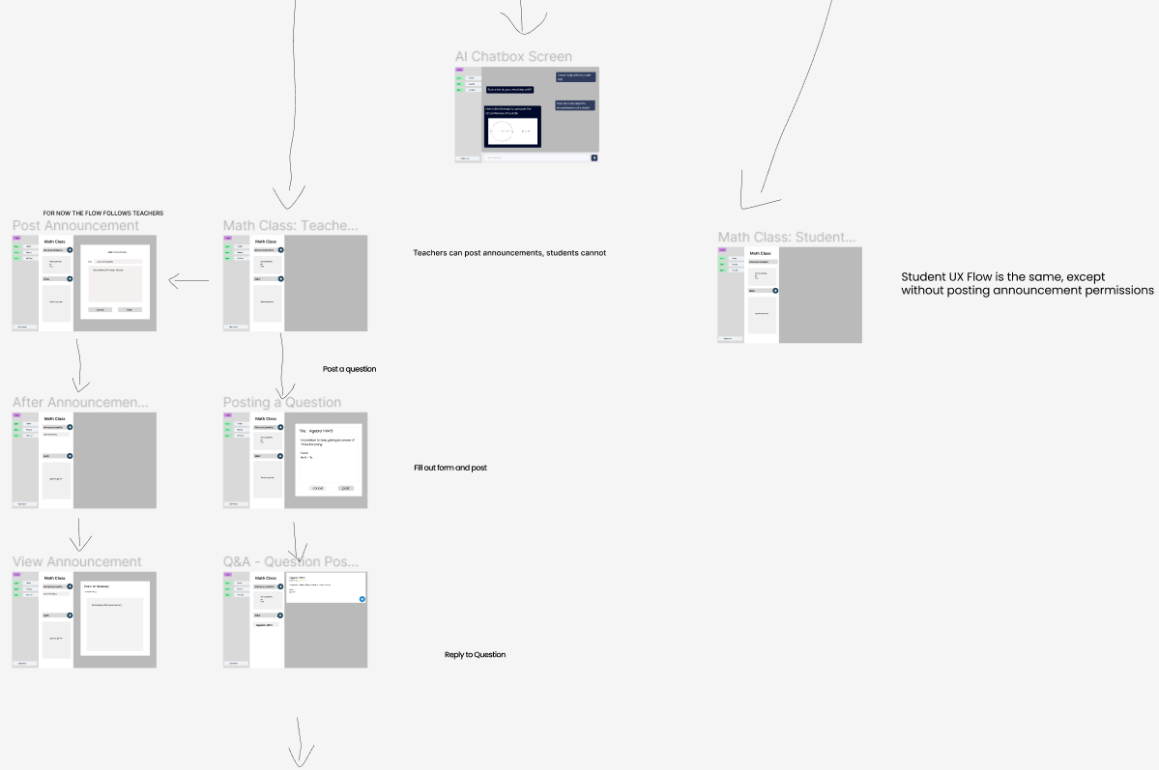
Figma 2/3

Slide 6
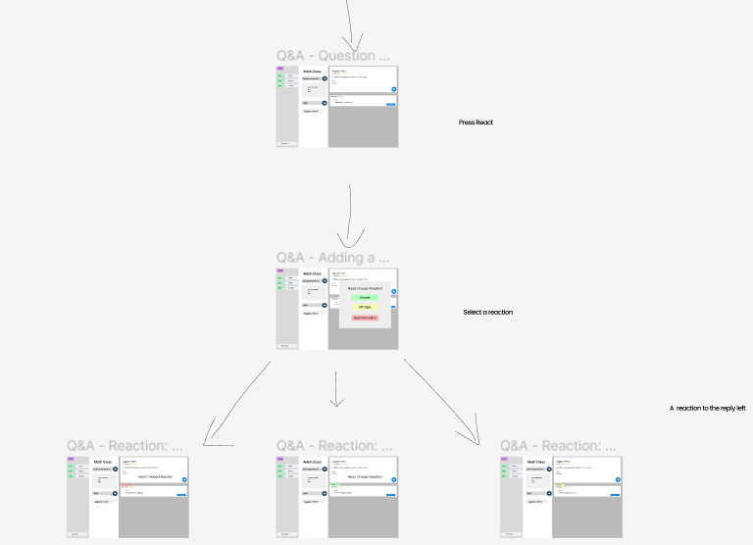
Figma 3/3

Slide 7
Front End Team: Collins and Salvador
Karma Points promote helping others
Insightful Reactions - Reduce scrolling
AI Tutor
Kept things as simple and intuitive as possible
Used Material UI Library to get a good framework of how we wanted our site to look
Made components as modular as possible so development was more straightforward
Things we can add in the feature
Different themes (dark/light mode)
Make more aesthetically pleasing

Slide 8
Back End Team: Luke (Back-end lead), Zach (Back-end support)
MongoDB
Testing

Slide 9
Git-Hub Team: Zach (Git-Master), Kao
Branch management
Feature branches
Pull Requests
Main is protected
Merges to main req Pull Requests
Code Reviews
1) Meaningful Names
2) Comment Code Blocks
3) No Broken Code (Test your code, resolve conflicts)

Slide 10

Scrum Master: Sean
Frequent meetings.
Task Management with Jira.
Help each other.
Study together.
Snacks.

Slide 11
QA

